Slide 1
Blockchain Platforms
Source of most materials:
Xiwei Xu, Ingo Weber, and Mark Staples. Architecture for Blockchain Applications. Springer, 2019

Slide 2
Outline
Cryptography basics
Bitcoin
Ethereum
Hyperledger
Notes:
We’ll first start with a quick introduction to cryptography. This will provide us with some background needed to discuss blockchains’ design and implementation details.
Then we’ll discuss 3 popular BC platforms. Under each platform we’ll revisit TXs, blocks, and ledgers structures in more details.
Bitcoin and Ethereum are public-permissionless BCs, while Hyperledger Fabric is a private-permissioned (aka consortium) BC.
This will be only an introduction. Some of the concepts like mining and consensus will be discussed in detailed later.

Slide 3
Cryptography Basics
Notes:
Let’s have a crash course in cryptography.
If you are not familiar with the basic ideas presented in the next couple of slides, it is highly recommended that you self learn a bit about them. Cryptography | Computer science | Computing | Khan Academy would be a good starting point if you want to start from very basics.

Slide 4
Blockchain
Replicated & distributed ledger – Linked list with hash pointers
Collection of ordered TXs form a block’s body
Summary of those TXs & hash of previous block forms a block’s header
Collection of blocks form a blockchain
Based on Public-Key Cryptography & Hashing
Latest Block
Genesis Block
H(Previous block)
H(Previous block)
H(Previous block)
Transaction 1
Transaction 2
Transaction 3
…
Transaction 1
Transaction 2
Transaction 1
Transaction 2
Transaction 3
…
Notes:
In the previous class, we talked about BCs goal, which is to replace the central trusted authority with a network of computers such that we establish a decentralised, trustless environment.
From an implementation point of view, BC is a replicated or distributed ledger which looks like a linked list with hash pointers distributed over a network of nodes.
In the latter part of the last lecture, we also discussed about challenges associated in building a
decentralized & consistent ledger
with the ability to prevent double-spending
and with high availability
while overcoming challenges such as:
unreliable networks
timing & ordering issues
faulty & misbehaving nodes
Next, we discuss another part of the solution which is Public-Key Cryptography & Hashing

Slide 5
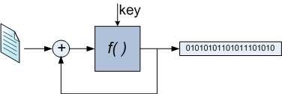
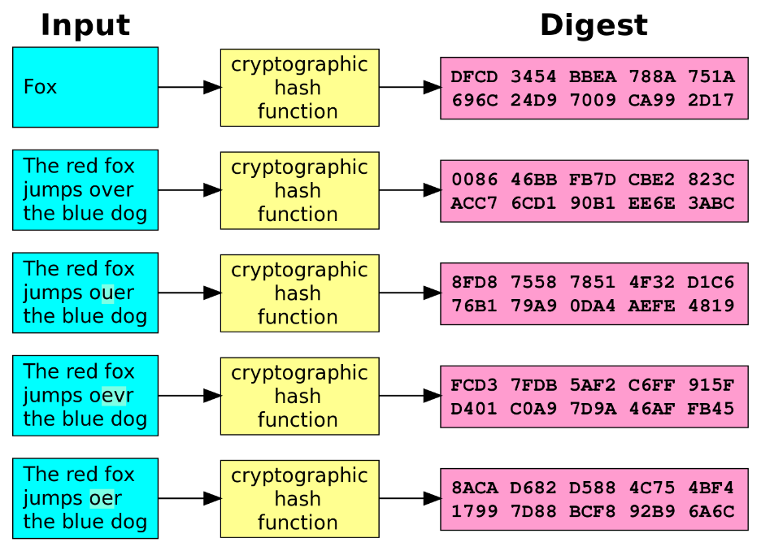
Hashing
Converts a large volume of data into a small datum
Maps arbitrary-sized data to fixed-sized data
Returned value is called a hash value, hash code, digest, or simply hash
Algorithms
MD5, SHA, SHA-3, KECCAK
64, 128, 160, 224, 256, 384 & 512 bits
Input Value Hash value
Source: https://en.wikipedia.org/wiki/ Cryptographic_hash_function
Notes:
Hashing is the process of converting a large amount of data into a small datum.
In the top figure, given a document, we use a special function to derive a small bit string that sort of becomes a “fingerprint” for the document.
We chose this function such that it can capture even a minor change in the document by producing a significantly different bit string from the original bit string (see next figure).
The function can take in arbitrary long input and produce a fix-sized output.
Such a function is called a hash function, and the resulting bit string is called the hash, hash value, hash code, or digest.
Some of the popular hash functions are MD5 and variants of SHA like SHA2 and SHA3.
MD stands for message digest and SHA stands for Secure Hash Algorithm. SHA-3 belong to a family of algorithms called KECCAK.
The hash value produced by these algorithms can be of various lengths like 64-bit, 128, 160, 224, 256 bits and so on.
Many BCs use 256 hash values, e.g., Bitcoin use SHA-3-256 and Ethereum uses KECCAK-256

Slide 6
Properties of Cryptographic Hash Functions
Deterministic
Same message always results in the same hash
A small change to a message changes hash value so extensively that old & new hash values appear uncorrelated
Called “Consistent Hashing”
Quick to compute hash value for any message/document
One-way functions
Infeasible to invert (i.e., generate a message from its hash value) except by trying all possible messages
Infeasible to find 2 different messages with the same hash value
If happens, it’s called a “Hash Collision”
Notes:
While there are many hash functions, hash functions used for cryptographic purposes usually have the following desirable properties:
The hash value should be deterministic where the same input always results in the same hash.
A small change to an input/message should change the hash value so extensively that the new hash value appears uncorrelated with the old hash value. This property is useful to prevent someone from guessing a hash value for a modified document.
Such hash functions are called Consistent Hashing.
The hash value of a given message or document should be computed fast. There is even specialised hardware to speed up hash calculations.
They should be one-way functions.
Hence, given a hash, we should not be able to derive the corresponding message. Therefore, the only way to generate a message from its hash value is to try all possible messages.
It should be practically infeasible to find 2 different messages with the same hash value. If this happens, it’s called a Hash Collision.
The possibility of a hash collision can be reduced by increasing the length of the hash value, e.g., most BCs used hash values of 256 bits or more.

Slide 7
Merkle Tree
A binary tree built using hashes
Allow efficient & secure verification of contents of large data structures
Can efficiently demonstrate a leaf node is a part of a given hash tree
H( )
H( )
H( )
H( )
H( )
H( )
H( )
H( )
H( )
H( )
H( )
H( )
H( )
H( )
H(Tx₁)
H(Tx₂)
H(Tx₃)
H(Tx₄)
H(Tx₅)
H(Tx₆)
H(Tx₇)
H(Tx₈)
Notes:
Merkle Tree is a data structure that consists of a binary tree of hashes.
In the context of BCs, the leaves of the tree are hashes of transactions (TXs).
Then we concatenate 2 TX hashes and compute their hash, e.g., H(H(TX₁) + H(TX₂)).
Then we concatenate 2 of those hashes and calculate another hash. We continue this process until we reach the root of the tree.
This allows us to summarise 8 hashes using a single hash. If we have n TXs height of the tree is log2(n).
A Merkle Tree is a way of efficiently & securely verifying the contents of a large collection of data. In BCs, it is used to summarize the set of TXs included in a block. So even if a single TX changes, the root hash will change.
Also, in BCs, we can verify whether a given TX is included in a block using the Merkle Tree. Given a TX and hashes of its adjacent and parent hashes, we can verify whether the same root hash is produced in Θ(log n) time.
For example, the block header will contain only the root hash, To check whether TX₄ is in the block, we need only to compute H(TX₄), concatenate it with H(TX₃) and find the next level hash. Then concatenate that hash with the hash from the left of the tree (i.e., H(H(TX₁) + H(TX₂)) ) and calculate the next level hash, and so on..,
Such a proof is called a Merkle proof.
In Bitcoin, if there are an odd number of TXs, the TX without a partner is hashed with a copy of itself. Similarly, any hash without a partner is hashed with itself.

Slide 8
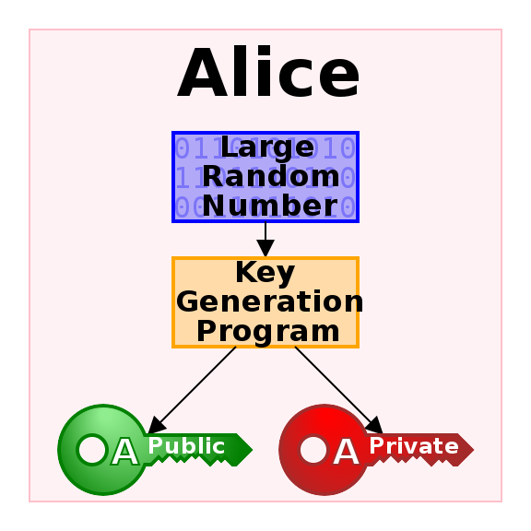
Public-Key Cryptography
Is a cryptographic system that uses pairs of keys:
Public key – May be disseminated widely
Private key – Known only to the owner
Aka asymmetric cryptography
Effective security only requires keeping the private key private
Easy to create new key pairs
Algorithms – RSA, ECC
128, 256, 384, 512, 1024, 4096 bits
Used heavily in blockchain
Losing your private key can mean loss of assets
If hackers can get your private key, they can steal your assets
Source: https://en.wikipedia.org/wiki/Public-key_cryptography
Notes:
Public-Key Cryptography is the foundation for digital signatures in BCs.
It uses a pair of keys to encrypt and decrypt data:
One of the keys is called the Public key and is expected to be disseminated widely.
The other key is called the Private key and is expected to be known only to the owner.
Because these cryptographic systems use a different key, they are also called asymmetric cryptography.
Owner of a private key needs to keep it private to achieve security.
It's easy to create new key pairs using algorithms such as RSA and ECC (Elliptic curve cryptography).
These algorithms rely on a large number as the seed to generate a key pair, e.g., you can wiggle your mouse several times to generate a large random number.
Typical key lengths are 128, 256, 384, 512, 1024, 2048, and 4096 bits.
Longer keys typically enhance security.
With RSA we use key lengths over 2048 today. ECC keys are relatively short as they are more effective in withstanding attacks. E.g., 384-bit ECC has similar strength as 4096-bit RSA key.
Bitcoin uses Elliptic Curve Digital Signature Algorithm (ECDSA) with the secp256k1 curve, which generates 256-bit keys.
In BCs, public-key cryptography is used to indicate the ownership of assets and authentication to spend them (see next slide).
E.g., when Alice sends $300 to Bob, she needs to sign her TX using her private key (as she’s the only one that is supposed to know the private key).
If Alice loses her private key, it same as her losing control of her assets.

Slide 9
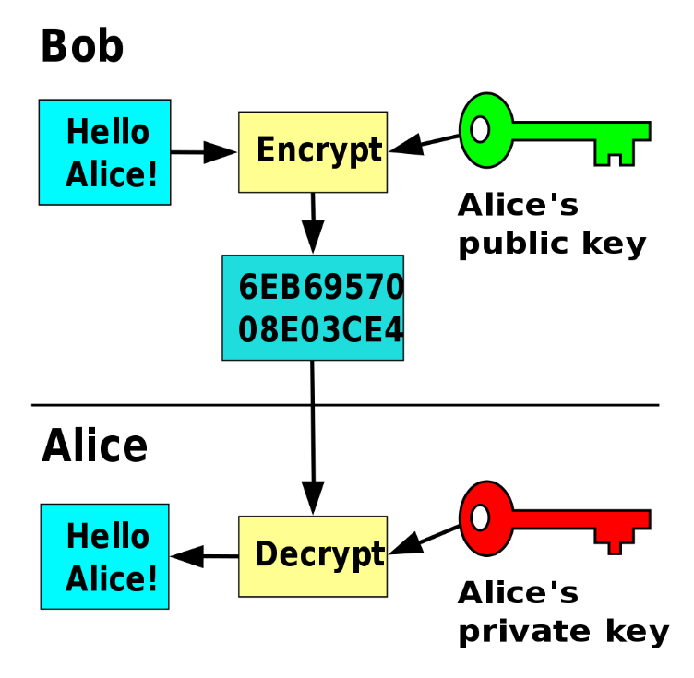
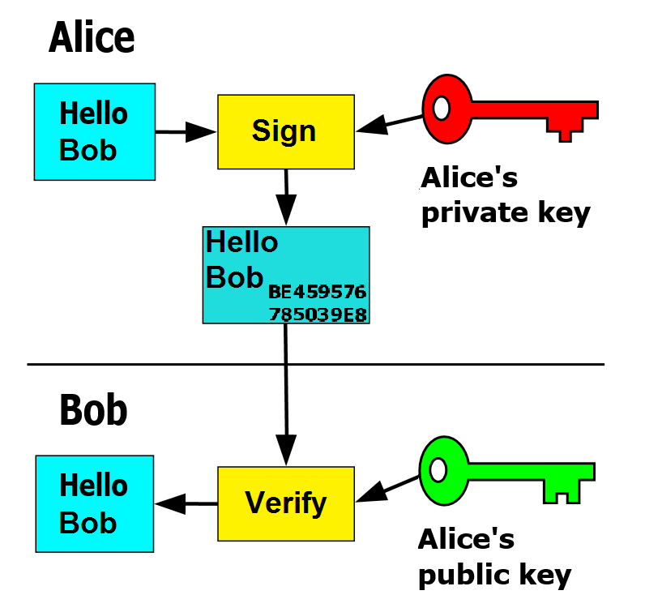
Encryption & Digital Signatures
No one can change message without breaking Alice‘s signature
Provides authentication
Only Alice can decrypt message
Provides secrecy
Source: https://en.wikipedia.org/wiki/Public-key_cryptography
Notes:
Public-Key Cryptography serves 2 purposes, where it can be used for encryption and digital signatures
Encryption
On the left, Bob wants a send a secret message to Alice.
So he encrypts the message using Alice's public key, which is well known. In fact, anyone that knows Alice’s public key can send her a secure message.
However, to decrypt the message Alice needs to use her private key. As Alice is the only one who knows the private key, no one can read the message other than Alice.
So use the public key to encrypt and the private key to decrypt.
Digital signatures
In digital signatures, the use of key pairs is reversed.
In this case, Alice wants to prove that she is the one who signed the message, i.e., Alice is trying to prove her authenticity (much like putting her signature on a paper).
So the message is signed with Alice's private key and Bob or anyone else can verify it using her public key.
No one else can impersonate Alice unless they know her private key
In practice, what is signed is a datum/hash of the message, which is not shown in the diagram to keep it simple. As a hash is much smaller than a document or TX, it is faster to sign on a hash than the original data.

Slide 10
Public-Key Cryptography in Blockchain
Use private key to control an account
Control means the ability to act on behalf of the account
E.g., spending assets it owns
Each account is known by its public key
“Alice” here is really 0x7a2f16dab8b5c2cf99c35e4c6a5beb45c7df8f87 → Pseudo-anonymous
For some accounts, we may know the person/organisation owning it
But by default, we don‘t
Source: https://en.wikipedia.org/wiki/Public-key_cryptography
Notes:
Here we talk about the specific use of public-key cryptography in BCs.
To transfer 5 Bitcoin (currency symbol BTC) to Bob, Alice needs to prove to Bitcoin miners that she controls the transfer account.
Ownership of an account in BC is proven using the private key, as only the owner of the key is supposed to know it.
Therefore, Alice signs the TX using her private key.
Whereas each account is known based on its public key. Hence, anyone can use her public key to verify that the TX was signed by Alice.
In practice, an account in Ethereum is derived from a 256-bit public key and reduced to 160-bit address for convenience. The private key is still 256-bits.
Note that Alice's account is represented as a bit string like in the slide.
Such a bit string gives pseudo-anonymity than keeping track of Alice’s name (more on this later).
However, for some accounts, we may know the person/organization owning it. But by default, we don‘t know.
In fact, in Bitcoin, it's even recommended to create a new account for each new TX such that you can achieve some level of anonymity.

Slide 11
Transactions, Blocks, & Ledger Structures
Notes:
Now that we have an understanding of terms like hashing, Merkle Tree, and digital signatures, let’s discuss the structure of a TX, block, and ledger.

Slide 12
Cryptocurrency
Digital currency baked into a blockchain & secured by cryptography
Accounting & validation rules are hard-coded in the platform’s base layer by developers
A platform typically has one base cryptocurrency
aka native currency
Not centrally issued, e.g., Bitcoin & Ethereum
Can be mined or purchased from cryptocurrency exchanges
Usually only on public blockchains
Usually don’t represent other rights/assets
Notes:
Here’s a single slide introduction to cryptocurrencies which are digital assets (aka crypto-assets).
A cryptocurrency is baked into a blockchain & secured by cryptography.
Accounting & validation rules are hard-coded in the platform’s base layer (aka BC protocol) by developers.
A platform typically has one base cryptocurrency. However, other forms of currencies/tokens may exist for governance, staking, etc.
aka native currency
Cryptocurrencies are not centrally issued by a central party like a central/reserve bank, e.g., Bitcoin & Ethereum.
They can be mined by joining the network or purchased from cryptocurrency exchanges.
They usually exist only on public blockchains.
In most cases, they usually don’t represent other rights/assets like a land title. Coloured coins are an exception whereas a Bitcoin UTXO represents some other asset.

Slide 13
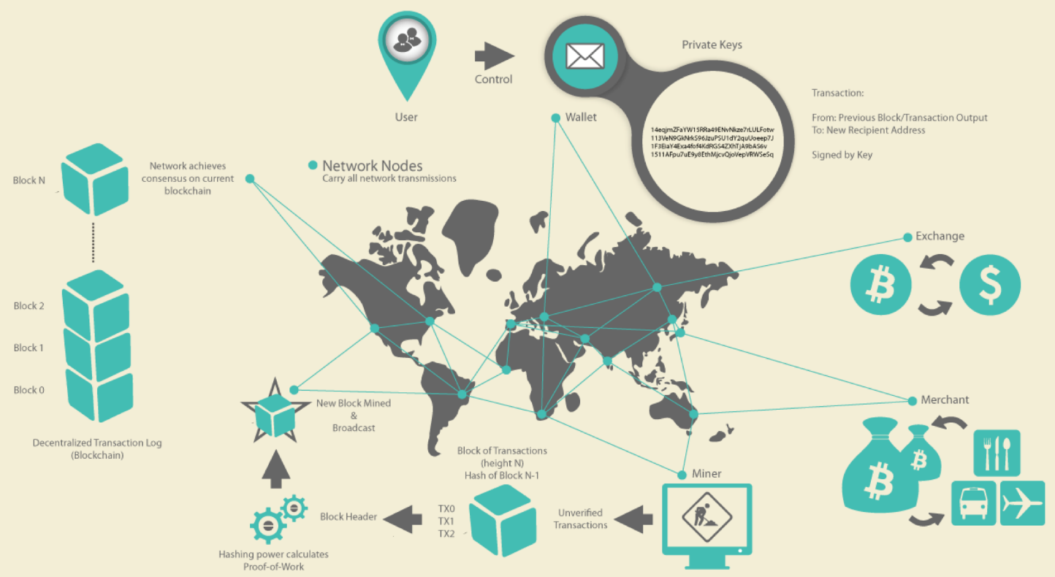
1st Gen Blockchains — Cryptocurrency
Users:
Create TXs,
Sign them
Announce them to network
Miners:
Receive TXs
Include them in a new block
(Try to) append new block to the chain of blocks
When a TX is part of the data structure, it has taken place
Exchanges:
Users can trade Bitcoin with fiat & cryptocurrencies
Send 2 BTC from my account to Bob.
Signed: Alice
Source: Andreas M. Antonopoulos, Mastering Bitcoin-Unlocking Digital Cryptocurrencies
Notes:
1st generation blockchains focused only on cryptocurrencies.
Bitcoin is the 1st cryptocurrency on a blockchain.
Bitcoin ecosystem consists of 3 roles, namely users, miners, and exchanges.
Users create TXs, sign them, & announce them to the Bitcoin network.
Miners receive TXs, include them in a new block, and try to append a new block to the chain of blocks. If successful, the block and its TXs are considered to have taken place.
Exchanges are used to trade Bitcoin with other fiat and cryptocurrencies.

Slide 14

Bitcoin
1st cryptocurrency (BTC) built on the idea of a blockchain
2008 white paper by Satoshi Nakamoto – Paper never used the word “blockchain”
Implementation in Jan. 2009
Blockchain keeps track of the ownership of portions of that currency
Miners compete to build the next block
Average time between blocks, called inter-block time, is ~10-min
But variation of times is high
Notes:
Bitcoin is the 1st cryptocurrency built on the idea of a BC. Both the BC network and currency are called Bitcoin and the symbol is BTC.
It was proposed in a 2018 white paper by a pseudonym called Satoshi Nakamoto.
The white paper never used the word BC. But as Bitcoin followed the linked-list structure forming a chain of blocks, BC became a synonym for the data structure that links blocks. It is also used to refer to the network of nodes too.
Implementation appeared in Jan. 2009.
On 3 January 2009, the Bitcoin network was created when Nakamoto mined the starting block of the chain, known as the genesis block.
The software was published by Satoshi Nakamoto under the name "Bitcoin", and later renamed to "Bitcoin Core" to distinguish it from the network, It' it’s also known as the Satoshi client.
Bitcoin BC keeps track of the ownership of portions of cryptocurrency, i.e., Bitcoins associated with each address.
As discussed in the last lecture, a block mainly contains a bunch of TXs and a reference to the previous block.
Miners compete to build the block and a new block appears after several minutes.
The time between 2 blocks is called inter-block time.
The average inter-block time is 10-min. However, it changes widely from a couple of minutes to even high as 20 - 30 min.

Slide 15
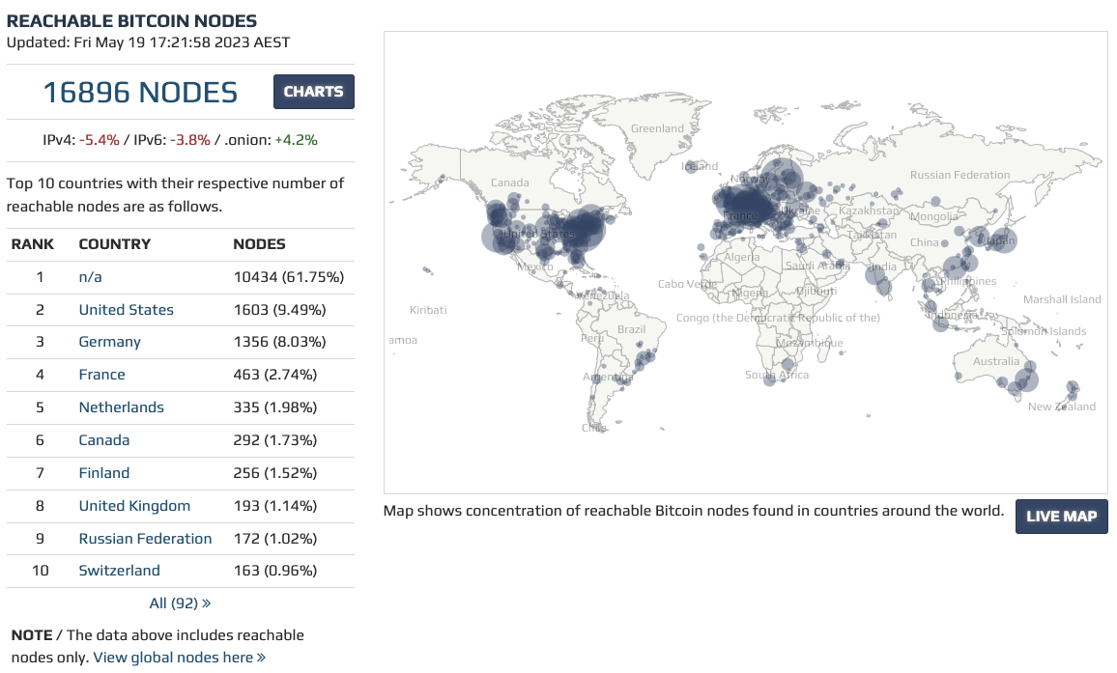
Bitcoin Network Distribution
Source: https://bitnodes.io
Notes:
This is a visualisation of the node distribution in the Bitcoin network as of May 2023.
You can go to this website to see more recent details.
As per the statistics collected a few min ago, there are ~17K nodes in the network. This number can vary a bit and is typically above 15K.
The map shows the concentration of nodes where location can be estimated. So for a large portion of nodes, we don’t know the location.
It also shows the nodes with IPv4 and IPv6 addresses and the ones that are behind a VPN (virtual private network)
You can get a bit more details on the live map by visiting the bitnodes.io site.
Go to this website and explore a bit.
ASNs - Autonomous System number is an identifier of the ISP

Slide 16
Accounts & States
An account is associated with a cryptographic key pair
Public key – Used to create the address of an account
Private key – Sign TXs sent from the account
State of the blockchain
Account balances of all users
Result from the genesis block (very 1st block) & set of TXs included since
Some accounts can be pre-loaded with an initial account balance at the genesis
As TXs are grouped into blocks, when a new block is added the entire system moves from one discrete state to another
ID | Asset
Alice | 500
Bob | 1000
Charlie | 500
Dave | Plot 123 @ 2015
Sweet Mango | Bowen QUE, Org. Cert # 45781
Notes:
Let's discuss a few definitions which can be generalised to other BCs too.
A Bitcoin account is associated with a cryptographic key pair, where
The public key is used to create the address of an account.
The private key is used to sign TXs sent from the account (i.e., authenticate TXs).
An account has only a single public-private key pair.
The state of the BC is the account balance of all users. This is also referred to as the Global state or World state.
Account balance is the sum of BTCs (named UTXOs, discussed in the next slides) that an account has control over. Only only Alice, Bob, and Charlie’s balances but also other state maintained by the network (keeping track of other data is more complicated, and will be discussed later).
Each UTXO is bound to the owner’s public key
The state captures results from the genesis block (the very 1st block) & set of TXs included since.
Some accounts might be pre-loaded with an initial account balance in the Genesis block.
As TXs are grouped into blocks, the entire system moves from one discrete state to another through the creation of a new block.

Slide 17
Transactions
Transfer currency from source addresses to destination addresses
Contains 1+ inputs & 1+ outputs
If sum of outputs is less than sum of inputs, the difference is a fee to the miner
TX fee is an incentive for miners to contribute computing power & storage
Contains proof of ownership for each input, in the form of owner’s digital signature
TX output is bound to owner’s public key
Notes:
Bitcoin TXs have an interesting structure and are used to transfer Bitcoins from source addresses to destination addresses, like from one bank account to another.
A TX contains one or more inputs & one or more outputs. E.g., TX0 has 1 input and 2 outputs.
You can think of this as paying a merchant using multiple notes and coins and getting the balance in the same way.
Each of those outputs can be spent later in another TX. Think of the balance you get from the merchant, which can be spent somewhere else.
The difference between input & output values is taken as the TX fee by the miner. E.g., here 100,000 Satoshis 100K comes in. A Satoshi is like a cent. The total value of outputs is 90K. The remaining 10K is the TX fee.
Satoshi is the smallest unit of BTC and it's one 100 millionth of a single Bitcoin (eight decimal places as 0.00000001 BTC). Millibitcoin (mBTC) is 1⁄1000 of a bitcoin.
These TX fees are the incentive for miners to contribute computing power, storage, and bandwidth.
A TX contains proof of ownership for each input, in the form of a digital signature of the owner. That is the owner needs to sign the TX using his/her private key which the Bitcoin miners can validate using the owner’s public key.
An output arising from a TX is linked to an address to confirm its ownership. E.g., when Alice pays 2 BTC to Bob, the output of the transaction will contain Bob’s address. Then to spend that 2 BTC, Bob needs to use his private key to sign the corresponding TX.

Slide 18
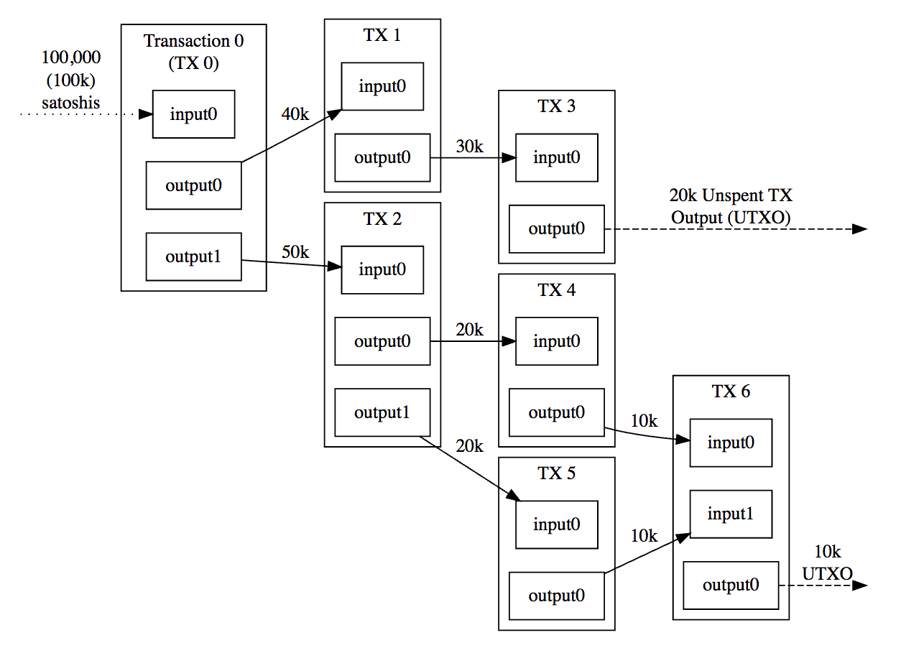
Transaction Format
Linked TXs
Outputs of TXs become inputs of a new TX
Bitcoin addresses don’t contain “coins” balance
Different to a bank account
Store Unspent Transaction Outputs (UTXO)
Balance of an address/account
Sum of values of all UTXOs associated with the address
State of the blockchain
All the UTXOs in system
Notes:
Bitcoin TXs are linked where the output of one or more TXs becomes inputs to a new TX.
Different inputs and outputs of the same TX are identified based on their index number.
However, compared to a typical account and balance maintained by a bank, Bitcoin addresses don’t contain “coins”.
Instead, these unspent outputs are called UTXO (Unspent TX Output). UTXOs are more like notes and coins in your wallet.
20k output from TX 3 is a UTXO.
Values in the figure are in Satoshis – A Satoshi is the smallest denomination of bitcoin, equivalent to 100 millionth of a Bitcoin (10⁻⁸).
A UTXO can be spent only once as an input to a TX.
UTXOs are bound to the recipient’s public key.
Actually, a UTXO is bound to the hash of the public key known as the address (an address also has a version number and a checksum to detect errors when specifying an address).
So if you want to find how many Bitcoins you own, you need to sum all UTXOs associated with your address. Following the notes and coins analogy in your wallet, if you want to know how much money you have, you need to count them.
Whereas the state of the blockchain includes all the UTXOs.
Bit“coin” is misleading, as fractional ownership, e.g., 1.64 BTC, is the norm.
A TX has a few other attributes like version number, locktime, and script which are not shown. See https://developer.bitcoin.org/reference/transactions.html for details
Locktime indicates the earliest time a transaction can be added to the blockchain. It can be specified as either a block no or a UNIX timestamp.

Slide 19
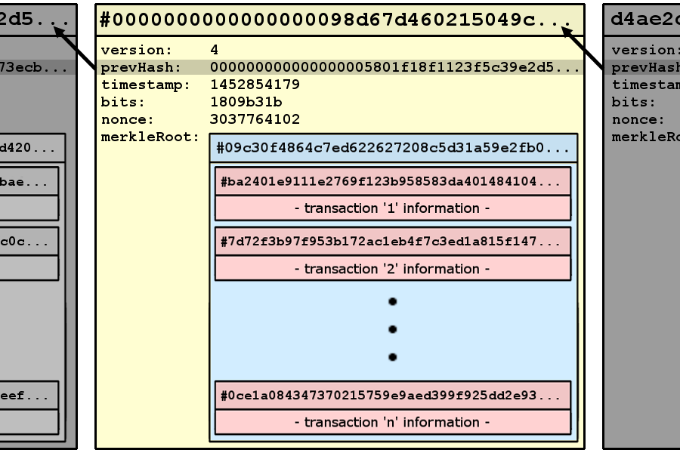
Blocks
A container of TXs
Identified by block hash
Linked to previous block
Includes a timestamp
Not very accurate
Include a nonce
Proof of ability to produce the block
Use a Merkle tree to capture an ordered list of TXs
Max block size is 4 MB
Max TX size is 100K bytes
Source: https://blog.scottlogic.com/2016/04/04/ jenny-from-the-blockchain.html
Notes:
As discussed earlier, a block is a container of TXs.
A block is identified by block hash, which is derived by hashing the block header.
In this figure, we have the block hash at the top.
Block links to the previous block using its hash (see prevHash).
Version number (4 bytes) helps a node to identify whether the rest of the network uses a new version of consensus rules that it may be not aware of. Bitcoin TXs also include a version no for the same purpose.
While the block includes a timestamp, it's not very accurate.
Due to clock drift, minors can set any timestamp within a certain window. Usually, this window can be as high as 2 hours into the future.
A block also includes a nonce (a random number), which is used as proof of the ability to produce the block
It can be considered a magic number that miners need to find to prove that they successfully build a block (more on this discussed later).
Then the ordered list of TXs is summarised using a Merkle tree
The block header is 80 bytes in length.
The Max block size in Bitcoin is now 4 MB, early days it was 1 MB.
4 MB comes from 4 million weight units, which is a measurement used to compare the size of different TXs to each other in proportion to the consensus-enforced maximum block size limit. It won’t be typically reached unless all TXs are formatted to minimise what’s included in the block. The typical max is 2.3MB if all TXs are segwit TXs. See https://en.bitcoin.it/wiki/Weight_units
There’s quite a lot of disagreement about whether the block size should be changed. Based on different block sizes, there are even sister BCs that were formed out of Bitcoin.
E.g., supporters of large blocks who were dissatisfied with the activation of SegWit forked the software on 1 August 2017 to create Bitcoin Cash, becoming one of many forks of Bitcoin such as Bitcoin Gold.
Max TX size is 100,000 bytes. While a typical TX is ~500 bytes

Slide 20
Mining – Creating a New Block
Receiving a new block
End of one round is the beginning of next round
Validate new block
Remove TXs of newly announced block from TX pool
Aggregate subset of the remaining valid TXs
Add coinbase TX as the 1st TX of the next block
Aggregation
Header Construction
Construct a Merkle tree to summarise all included TXs
Include hash of the previous block
Find solution to Proof-of-Work (PoW) algorithm called Hashcash
Result will be inserted into the block header, if successful
Solve puzzle
Propagation
Immediately propagate new block to other nodes
Notes:
Mining is the process of creating a new block. This diagram shows the overall mining process.
Once a new valid block is built and propagated to other nodes in the network, miners start building the next block while using the new block's hash as the previous hash.
Aggregation
First, they remove TXs of the newly announced block from a pool of pending TXs (aka transaction pool) as those are already in the block that was just announced.
Aggregate a subset of the remaining valid TXs.
Then add Coinbase TX as the 1st TX to the TX list for the next block.
Coinbase TX is a special TX used to claim the block generation reward. This is how new Bitcoins get generated.
Coinbase TX has a special condition that it cannot be spent (used as an input) for at least 100 blocks. This is related to the forking discussed in the next slide.
Header construction
Miner then calculates the Merkle Root.
Next, build the header by including the hash of the previous block and Merkle Root to summarize all the included TXs.
Solve puzzle
Find a solution to the Proof of Work (PoW) algorithm. If successful result (in this case nonce) is inserted to the block header. We’ll discuss these later
Propagation
Finally, a successful miner immediately propagates a new block to other nodes via the Internet.

Slide 21

Right to Build a Block
Miners compete to create new blocks by solving a hash puzzle known as Proof-of-Work (PoW)
Hashcash in Bitcoin & Ethash in Ethereum
Answer is difficult to compute, but easy to validate
No shortcuts, must try all possible answers
Difficulty of problem is automatically adjusted with time
Overcomes increasing computing power to maintain average inter-block time
Miners use specialised hardware to try multiple nonces at once
ASICs in Bitcoin & GPUs in Ethereum
See https://youtu.be/x9J0NdV0u9k
n-bit nonce
m-bit block data
+
Try another nonce
Hash()
0000xxxxxx
Accept if l 0s in prefix
(aka block difficulty)
Notes:
Let's discuss a bit about the mining process in Bitcoin.
Once a set of pending TXs are included in a block, miners need to solve a puzzle to build a block. Once they solve the puzzle only they can announce/propagate/broadcast the new block into the network.
The miner who solves this puzzle 1st is considered to have the right to build the block.
This puzzle is called Proof of Work (PoW) as it is difficult (computationally expensive, costly, and time-consuming) to solve the puzzle but easy for others to verify the answer. This is more like you solve a problem by spending an hour, while your teacher can verify your answer in seconds.
Bitcoin miners solve a puzzle called hash cash to build a valid block. Ethereum used an algorithm called Ethash (Ethereum 2.0 doesn’t use PoW).
PoW algorithms like hashcash are “embracingly parallel problems” with no shortcuts to finding the answer.
The diagram outlines the basic idea:
On one side you have the data that reflect the content of the block header like Merkle root, previous hash, and timestamp.
The bitcoin block header is 80 bytes including a nonce, i.e., m = 80 – 4 = 76 bytes.
On the other side, you have the nonce, a large random number.
In Bitcoin nonce is 32-bits (i.e., n = 4 bytes) and the resulting hash value is 256 bits.
You concatenate the 2 and calculate the hash value.
You then check whether the resulting hash value satisfies a certain properly. E.g., For here we check whether the hash has 4 zeros as the prefix. Such a hash is called a valid hash and the associate block is called a valid block.
In practice, the acceptance threshold can be more specific like a very large number.
The acceptance threshold is adjusted over time to ensure the average inter-block time remains 10-min with increasing computing power.
If not, you must retry again while changing the nonce. You can't change the m-bit data, as it reflects the content of the block. If you want to do that you have to do more work than just trying another nonce.
There's no easy way to guess what nonce would work. So you must try nonce values until you get lucky.
Hence, quite a massive number of hashes need to be tried before finding a hash value that satisfies the acceptance threshold. Thus, the process is computationally expensive and consumes lots of power.
While it's difficult to find what nonce work, easy to validate whether a given nonce satisfies the condition.
Just concatenate the claimed nonce with the block header, calculate the hash, and check whether the hash value satisfies the acceptance threshold.
The difficulty of the problem is automatically adjusted with time to overcome increasing computing power to maintain average inter-block time.
A simple adjustment would be to increase/decrease the number of leading zeros in the hash. But a finer control can be achieved by adjusting the massive number that is hash value is expected to satisfy.
Bitcoin – Every 2,016 blocks (approximately 14 days given roughly 10 minutes per block), nodes deterministically adjust the difficulty target/threshold.
Ethereum – Difficulty is adjusted every block.
This essentially means more computation the BC network put into solving the puzzle, and the difficulty of the puzzle gets increased, increasing the time to solve the puzzle. That way we can retain an average ~10-min inter-block time target.
Miners use specialised parallel hardware to speed up the process by computing multiple nonce values parallelly:
ASIC – Application-specific integrated circuit
GPU – Graphics processing units
As of April 2022, it takes on average 122 sextillion (122 thousand billion billion) attempts to generate a block hash smaller than the difficulty target.
The actual mechanism may slightly change from the given figure, e.g., instead of changing nonce on the block, miners may add a random value to coinbase TX to keep changing the block header until block difficulty is achieved. See https://en.bitcoin.it/wiki/Mining

Slide 22
Who can Build a Block?
Multiple miners might find & announce next blocks at the same time
Tiebreaker – Treat the longest history of blocks as the main chain
One that received the most computation
Referred to as Nakamoto Consensus
Orphan block
Confirmation blocks
Fork in the blockchain
Fork decided: longer chain wins
Notes:
By finding a valid hash miners gain the right to build the next block. However, it is possible for multiple miners to solve the problem simultaneously
This is quite possible in a global network like Bitcoin where it could take a few seconds for a newly generated block to propagate to a large fraction of the network.
Such blocks will not be identical in content at least because the coinbase TX is bounded to the miner’s address.
When that happens we need a tiebreaker.
Nakamoto proposed to treat the longest history of blocks and claimed it as the main chain.
The longest chain is also the one that received the most computation (more blocks behind it means more computation spent to solve the PoW puzzle).
In the figure, block n has 2 successors. Miners still allow subsequent blocks to be built while using these successors as the previous block.
Eventually, one of the forked chains will be longer than the others. In this example, the bottom chain will be accepted as the longer chain.
The top n+1 block is dropped from the chain of blocks, and all its TXs go back to the TX pool to be included in a block in the future. Such a block is called an orphan block.
Therefore, creating a block doesn't mean the block is finalized. Even the block reward is not guaranteed.
This approach of deciding what blocks are considered as finalised is called Nakamoto Consensus.
Occasional forking is common. However, extended forking is rare, and may be due to an explicit attack.
When forking is occasional, Nakamoto (see Bitcoin whitepaper) showed that the probability that a block is no longer in the longest chain rapidly reduces to zero as more blocks are built along the same chain of blocks.
Therefore, in Bitcoin and several other BCs, after a TX gets included in a block, we wait for more blocks to be formed along the same chain.
Each such block built after the block containing a TX of interest is called a confirmation block.
As multiple blocks may have the same block height (i.e., no of blocks in the longest chain since the genesis block), it’s not unique. Hence, block hash is the unique identifier of a block.

Slide 23
Nakamoto Consensus
To determine with high probability that a TX is permanently included:
Wait for several blocks (6 blocks by default) to be added after 1st inclusion of the TX in a block
Each of these subsequent blocks is called a “confirmation block”
Once sufficiently many confirmations occur after the TX inclusion in the block then TX is considered committed/finalised
Unlike many traditional TX commit semantics:
Commit only has a probabilistic guarantee
A longer chain could appear – although it may be very, very unlikely
Notes:
Let's talk a bit about Nakamoto Consensus.
To determine with a high probability that a block and its TXs are permanently included (i.e., in the longest chain), we need to wait for several new blocks to be added after the 1st inclusion of the TX in a block.
This way, we can give enough time for any forks to get resolved. Again here we are not talking about physical time, but the need to wait for enough new blocks.
In Bitcoin, we assume that it is enough to wait for 6 blocks once a TX is included in a block. 6-blocks are approximately 1 hour (10 min x 10).
This number is determined based on a probabilistic analysis in the Bitcoin white paper.
Each of these subsequent blocks is called a “confirmation block”. Once sufficiently many confirmations occurred after the TX is included in a block, then the TX is considered committed (aka finalised).
However, compared to traditional database-like TX commit semantics:
Commit only has a probabilistic guarantee as there is a non-zero probability (though extremely small) that a block may not be in the longest chain event after 10 or 12 blocks.
A longer chain could appear – although it may be very, very unlikely
In general, most BCs don’t fully comply with ACID (Atomicity, Consistency, Isolation, Durable) properties associated with centralised databases.
In practice, TXs need to be fast, persistent, & low-cost to be useful.

Slide 24
Transactions Lifecycle
Notes:
This is a state diagram of the lifecycle of a TX.
As soon as a TX is submitted to the BC, it is validated by the receiving node.
If valid, TX enters the pool of pending TXs (aka TX pool or mempool). If not, TX is dropped.
When a valid TX is included in a block, it moves to the “TX in block(s)” state.
If the desired number of new blocks are built after this, the TX is committed.
While Bitcoin assumes a TX is finalised after 6 new blocks, in Ethereum 1.0 we wait for about 12 blocks (approximately 3 min).
However, if the BC forks and the block with the TX isn’t included in the longest (or heaviest) chain, the block is discarded and all the TXs in the block are sent back to the TX pool.
While waiting in the pool, a TX may get dropped too. This could happen when the pending list of TXs is too long or the TX waited in the pool for a long time without being included in a block.
These parameters are BC platform-specific and under the discretion of the miner.
Typically, miners prefer to include TXs willing to pay a high TX fee. Hence, when the TX pool is too full, minors 1st drop TXs with a low TX fee. Also, miners may even define a minimum TX fee to be included in the TX pool.
A dropped TXs may be resubmitted with the same or a higher TX fee.
While a TX is pending in the pool, another TX can be submitted with a higher TX fee and (same nonce in Ethereum) to replace the existing TX. In that case, the original TX becomes outdated.
However, this may not work always as altruistic miners may retain a TX in the pool regardless of its TX fee.
In practice, a few other complex scenarios could determine the lifecycle of a TX. However, this figure is abstract enough for the content of this class.

Slide 25
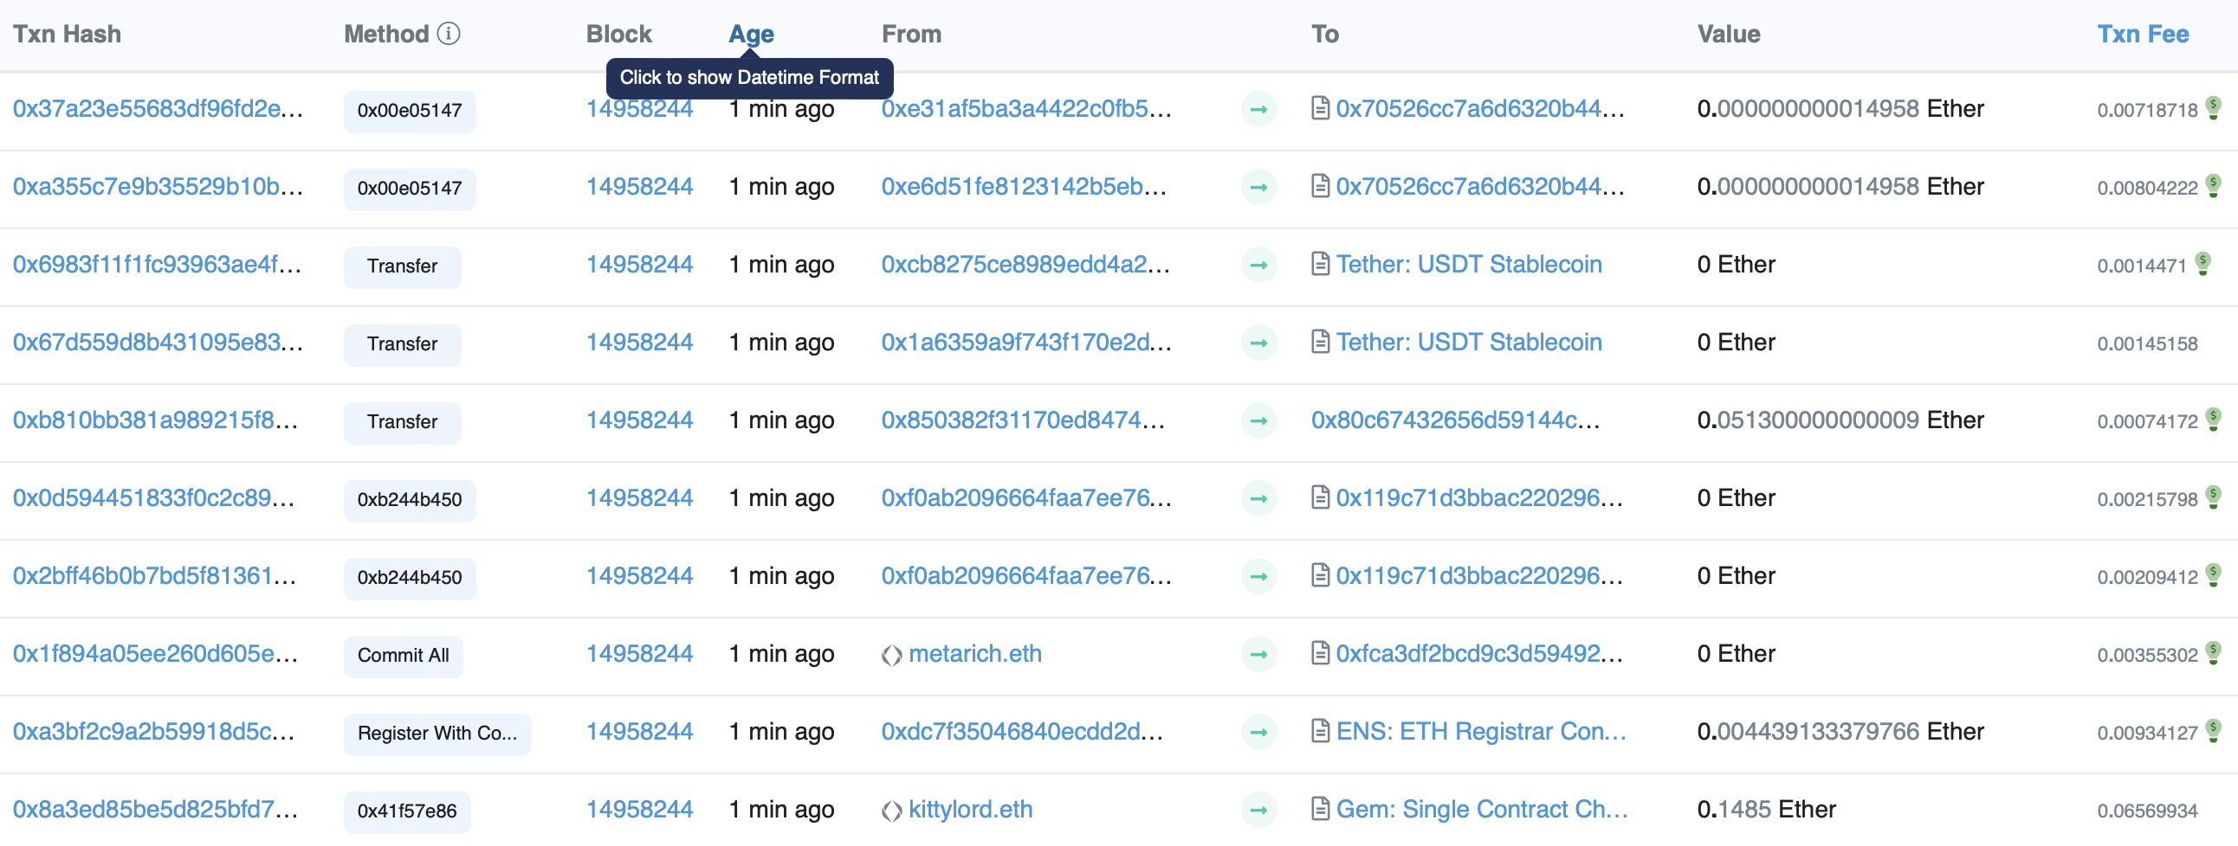
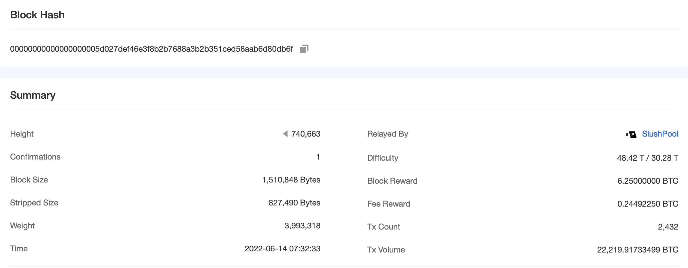
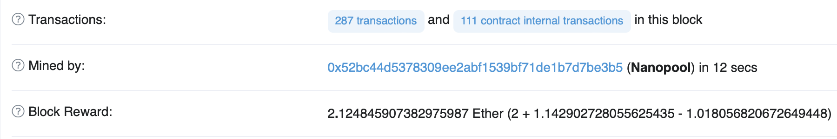
Mining Reward
Notes:
Miners who build valid blocks get rewarded for their effort in 2 ways:
Block reward – New cryptocurrencies generated as part of block generation are assigned to the miner (included through coinbase TX).
TX fees – Fees paid by users to get their TXs included in the block, e.g., the difference between inputs and outputs in a Bitcoin TX.
On the left, we have a screenshot of a mining reward from a Bitcoin block. It also shows the block difficulty and miner “SlushPool”.
This shows that SlushPool received 6.25 BTC as the block reward and 0.2449… BTC as TX fee.
On the right we have such information from Ethereum:
At the top, we have a list of TXs that were included in the block.
Miner is Nanopool
While there are both a block reward and TXs fees, a bit of Ether is destroyed as well.
The London upgrade included Ethereum Improvement Proposal ("EIP") 1559, a mechanism for reducing transaction fee volatility. The mechanism causes a portion of the Ether paid in transaction fees for each block to be destroyed rather than given to the miner, reducing the inflation rate of Ether and potentially resulting in periods of deflation.

Slide 26
Mining Reward (Cont.)
Miners who build valid blocks get rewarded for their effort in 2 ways
Block reward
With each block, new cryptocurrency is generated & assigned to the miner
Bitcoin – Block reward is added as a special TX into the block, called “coinbase TX”
6.25 BTC since May 2020, 12.5 BTC reward in 2016, 50 BTC initially
Reward halved every 210,000 blocks
In Ethereum, block reward is credited to miner’s address
2 ETH since block# 7,280,000, 3 ETH between 4,370,000 & 7,279,999, 5 ETH initially
TX fees
Miners can collect fees from TXs they include in the block
Higher TX fee → Higher chance of TX getting included in a block
Notes:
Miners who build valid blocks get rewarded for their effort in 2 ways:
Block reward
With each block built, new cryptocurrencies are generated and assigned to the miner.
Bitcoin
The block reward is added as a special TX into the block, called coinbase TX.
Reward halved every 210,000 blocks, e.g., 6.25 BTC since May 2020, 12.5 BTC reward in 2016, and 50 BTC initially.
Eventually, the reward will round down to zero, and the limit of 21 million bitcoins will be reached approximately in 2140. The miner’s effort will then be rewarded by TX fees only.
Ethereum (we are jumping the Ethereum discussion a bit here just for the same of a comparison)
The block reward is credited to the miner’s address.
Ethereum reward adjustment is not regular like in Bitcoin, e.g., 2 ETH since block# 7,280,000, 3 ETH between 4,370,000 & 7,279,999, and 5 ETH initially.
Also, Ether has no supply cap.
TX fees
Miners can collect fees from TXs they include in the block.
Hence, they are incentivised to prioritise TXs that pay higher fees.
Typically higher TX fee increases the chance of a TX getting included in a block soon.
TX fees can be complex and how they are charged changes across BC platforms, e.g.,
The London upgrade in Ethereum since block# 12,965,000 burn a portion of the Ether paid in transaction fees for each block to be destroyed rather than given to the miner.
Essentially base fee (which is dynamic) is removed and miners are only allowed to retain what was paid above the base fee.
This reduces the inflation rate of Ether and potentially results in periods of deflation. See https://eips.ethereum.org/EIPS/eip-1559

Slide 27
Question
Which of the following statement(s) is True?
As the number of ledger copies increases, it becomes difficult to maintain the consistency of the ledger.
Given a hash value, we can derive the corresponding message.
An attacker can fabricate a TX using Alice’s public key to show that Alice is engaged in illicit TXs (e.g., money laundering).
As soon as a Bitcoin TX is included in a block, it is safe to assume the TX is final (e.g., Charlie can ship a bicycle to Alice).
✓
X
X
X

Slide 28

Ethereum
2nd generation blockchain that can execute programs called Smart Contracts
Ledger that can store/transact any kind of data
Native currency is Ether (ETH)
 | Ethereum 1.0 (Eth1) | Ethereum 2.0 (Eth2)
Consensus | Proof of Work (PoW) | Proof of Stake (PoS)
Inter-block time | Average 13-15 sec | Regular 12 sec
Confirmation blocks | 12 | Max 64
Ledger | Replicated | Replicated
Performance | Low | High*
Power consumption | High | Low
Notes:
As Ethereum fully supports smart contracts (SCs), it's considered a 2nd generation BC.
SCs are small programs that execute on a DLT. More on SCs in the next class.
Even Bitcoin supports a limited set of SC features. However, it's Ethereum that demonstrated the true power of SCs.
With the introduction of SCs, the Ethereum ledger enabled the storage and transaction of any kind of data.
Ethereum was conceived in 2013 by Vitalik Buterin. In 2014, development work began and was crowdfunded, and the network went live on 30 July 2015.
Development was funded by an online public crowd sale from July to Aug 2014, in which participants bought the Ethereum value token (Ether) with another digital currency, Bitcoin.
The native currency is Ether (ETH).
ETH balance denominated in Wei (10¹⁸ Wei = 1 Ether)
Today, we have 2nd version of Ethereum that has a few notable differences from its initial version:
Consensus
On Sep 15, 2022, Ethereum switched its consensus algorithm from PoW to PoS (Proof of Stake)
PoS protocols are a class of consensus algorithms that work by selecting validators/miners in proportion to their quantity of holdings (i.e., stake) in the associated cryptocurrency (ETH).
This essentially means that rather than selecting a miner to build the next block based on its computing power, a miner (minors are now called validators) is selected based on the amount of ETH in stakes. The actual protocol is more complicated and we’ll discuss PoS in a later class.
The original PoW algorithm was called Ethash. The key difference between Ethash and Bitcoin’s Hashcash is that it's also memory intensive making it difficult to solve the puzzle with hardware optimisations such as ASICs (Application-Specific Integrated Circuits). GPUs (Graphics Processing Units) were used in Ethereum.
Initial inter-block time was 13-15 sec. Now blocks are generally more regular at every 12 seconds.
Typically, 12 blocks of confirmation were used in Ethereum 1.0 before assuming a TX is confirmed. However, with the introduction of PoS, it can be now as high as 64 blocks. However, it is expected to reduce as the protocol undergoes further enhancements.
Ethereum 2.0 is still undergoing transition. E.g., while the current ledger is fully replicated, Ethereum plans to decentralise the ledger using a technique called sharding.
Sharding will split the ledger into different segments and each segment will have a relatively smaller number of replicas. This enables parallel execution of TXs.
Due to sharding and the slight reduction in inter-block size, Ethereum 2.0 is expected to handle a much higher number of TXs. Hence, throughout (one of the performance metrics that count the number of TXs processed within a unit of time) is expected to be 2 orders of magnitudes higher than current performance.
As PoS doesn’t waste power to solve a puzzle like in PoW, the power consumption of Ethereum 2.0 is several orders of magnitude lower than what it used to be before Sep 2022. It is estimated that the power consumption is dropped by ~99.95%.
See https://ethereum.org/en/roadmap/merge/ for high-level details of Ethereum’s transition from version 1.0 to 2.0

Slide 29
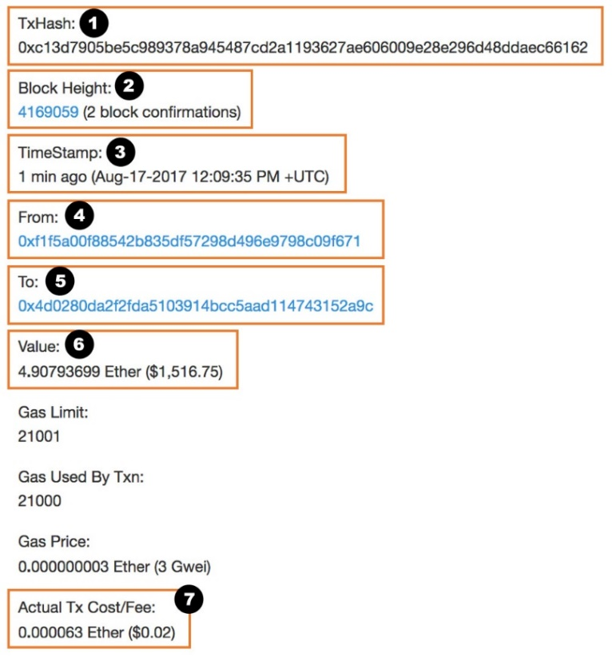
Accounts & Transactions
Uses account-balance model
An account is bound to owner’s public key
A TX is uniquely identified by its hash
TXs are sequenced using a nonce
Once included in a block, block no, actual gas used, actual fee, etc., are available
From – Source address (regular account)
To – Destination address (regular account or contract address)
Value – Ether (in unit “wei”) to transfer to destination (can be 0)
Nonce – TX sequence no for source account
Gas price – price you are offering to pay (Ether per gas)
Gas limit – Max amount of gas allowed for TX
Data – Payload data (TX memo, binary code, or function invocation)
Digital signature (field names: v, r, s)
Notes:
While Bitcoin uses UTXO, Ethereum uses the typical account-balance model where the ledger maintains the balance of each account.
An account is bound to the owner’s public key.
TXs and blocks are uniquely identified by their hash values.
TXs from the same account are ordered by a sequence number called the nonce. This nonce doesn’t have anything to do with the nonce in a block used by PoW protocols.
As we saw with Etherscan a TX has a hash, from & to address, nonce, value or data, and a TX fee.
In Ethereum, TX fee has 2 parts, a gas limit and a gas price. We’ll soon discuss gas…
Gas limit - is the maximum amount of gas the TX issue is willing to spend.
Gas price - is the amount of Ether the TX owner is willing to pay for a unit of gas
Once a TX is included in a block, block no, actual gas used, actual fee, etc., are available.

Slide 30
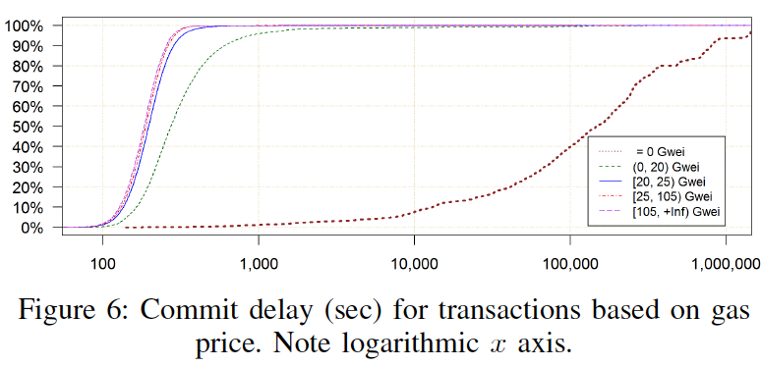
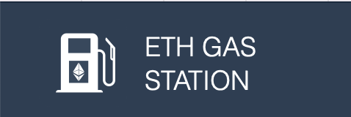
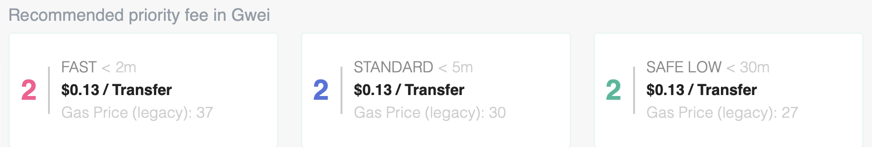
Transaction Fees
Sender decides on TX fee to offer
Can be 0. Minimum on some platforms
Miners prefer TXs with higher fees
Altruistic mining
Higher TX fees → Fast inclusion in a block
TX fees are dynamic
No of pending TXs
Cryptocurrency price
TX urgency
Errors & attacks
Source: Ingo Weber et al., “On availability for blockchain-based systems”, 2017 IEEE 36th Symposium on Reliable Distributed Systems (SRDS).
Notes:
In most public BC platforms, the sender decides the TX fee to offer.
While it can be 0, some platforms set a minimum TX fee, e.g., Ethereum has a minimum fee, but the miner may decide to change that.
Miners prefer TXs with higher fees as it is part of their income.
There are a few altruistic miners who don’t care about mining fees. Or miners charge no fee from these TXs.
Because of these, occasionally you would see even TXs with no or very low fees may get included in a block.
Typically, a higher TX fee increases the chance of a TX getting included in a block soon.
E.g., the CDF shows that Ethereum TXs with high fees are included faster, while TXs with low fees can be significantly delayed. Even for the same TX fee, some TXs may experience substantial delays.
TX fees are dynamic and depend on many factors:
No of pending TXs – As the block size is limited (in terms of the block size or gas limit) when too many TXs are pending to be included in a block we have a high demand and limited supply scenario. Similar to other goods in a market, the TX fee goes up as the TX senders with high urgency will start offering higher prices.
Cryptocurrency price – Typically when the price increases concerning say USD, TXs fee goes down as miners’ effort to maintain their computing infrastructure is reflected in USD. However, when the cryptocurrency price goes up, there can also be an increase in no of TXs increase the number of pending TXs in the pool.
TX urgency – Users’ urgency depends on the use case, this is common during initial coin offerings (ICOs), gambling, and some NFT (non-fungible token) sales.
Errors are not uncommon where someone may accidentally put TX value as TX fee. Or an attacker may pay someone’s currency as a TXs fee to any miner who’s able to build that block.
Due to multiple such factors, TXs fees can vary widely
We could use services such as ETH gas station to get an estimate on a suitable TX fee depending on how soon we want the TX to be included in a block. Note that since July 2023 ETH gas station is no longer in operation.
Wallets like Metamask and Ethereum node can also give you an estimate.
These services use various algorithms ranging from calculating mean/median value and moving averages to machine learning.

Slide 31

Gas in Ethereum
A unit of accounting for calculating TX fees
Based on computational complexity & storage needed to execute a certain operation/instruction
A fee to limit resource usage
Gas limit
A fixed gas cost per TX (base cost of 21,000 gas)
Plus, a variable gas cost for data (dependent on size) & execution of a SC method (charged per bytecode instruction)
Additional gas cost for deployment of new contracts
Gas price
Reflects how much Ether-per-gas the TX sender is willing to pay
Clients need to set the gas price to market price & their urgency
Use gas price recommendations from wallets & explorers
$$TX fee=Gas limit × Gas price$$
Notes:
Let’s now discuss a bit about how TX fees are calculated.
TXs fees are defined in a unit called gas.
Gas is a unit of account within Ethereum used in the calculation of the TX fee. This determines the amount of ETH a TX's sender must pay to the miner/validator who includes the TX in the blockchain.
Gas is calculated based on the computational complexity and storage needed to execute a set of operations/instructions triggered by a TX.
More complex computations or more storage means more cost. Hence, the gas acts as a fee to limit resource usage on the Ethereum network.
Offered TX fee consists of 2 parts, a gas limit and a gas price.
This is like the fuel cost of going on a trip. Depending on the efficiency of your car, you will need a certain number of litres of fuel. Then there is the fuel price. So, the total fuel cost is = no litters of fuel x price per litre.
Gas limit:
There is a fixed gas cost (aka base cost) for a basic cryptocurrency TX. Currently, it is set to 21,000 units.
If your TX include data or execute a smart contract method, then you must pay additional gas in proportion to the size of the data or complexity of bytecode instructions that are executed by the smart contract.
Further, additional gas cost needs to be paid for the deployment of a new contract.
Gas limit is also useful for the smart contract user, particularly to guard against errors such as infinite loops where bad code could quickly exhaust your Ether.
However, if we set a low limit, we run the risk of exceeding the gas limit before our code finish execution. If so, TX is reverted, but you lose the TX fee.
Anyway, we don’t want to set a very high limit as Ethereum nodes don’t also like excessively gas-consuming TXs due to the risk of denial service (DoS) attacks.
We can estimate how much gas a smart contract-related TX may consume. However, in practice, we set a slightly higher gas limit to accommodate any unforeseen changes in the size of data or code behaviour.
Gas price
Is the fee we are willing to pay for a single unit of gas? This should be specified in ETH.
Gas prices are typically denominated in Gwei, a subunit of ETH equal to 10⁻⁹ ETH.
While this is at the user’s discretion, if you offer to pay a much lower value compared to the market price, your TX could get delayed or even get dropped. Alternatively, you could increase the chance of including TX faster by offering to pay a higher gas price.
Gas price is dynamic and reflects the number of pending TXs. Some recommendations are available, e.g., services like ETH Gas Station and wallets like Metamask.
Set higher gas prices if the inclusion of TX is urgent
Set lower gas prices if TX inclusion is not (time) critical

Slide 32
Gas Limit
TX gas limit
Maximum gas TX sender is willing to pay
Gas used <= gas limit
Else, TX will fail & state changes are reverted. Sender is charged up to the gas limit
Block gas limit
Sum of gas used by TXs included in a block can’t exceed this limit
Limits complexity for a new block
Set by the miners
Max block size is ~30 million gas
Max 1,428 TXs/block (Bitcoin 1,500 TXs/block)
Most blocks under a few KB (Bitcoin 1 MB)
An upper bound on TX throughput
Nontrivial to understand how the bound relates to TX throughput
Notes:
There are two gas limits in Ethereum.
TX gas limit is the maximum gas the TX sender is willing to pay.
Gas used is the actual gas consumed by the TX and is set once the TX is included in a block.
Gas used <= gas limit.
Else, TX will fail and state changes are reverted. However, the TX sender is charged up to the gas limit specified.
We can estimate how much gas a particular TX is likely to use. However, there’s a possibility that other transactions may execute between the gas estimation and the inclusion of the said TX in a block. Due to the ledger changes caused by those TXs, the actual gas used could be higher than the initial estimate. Hence, it’s a good practice a set a slightly higher gas limit than the estimate, e.g., a 20% increase.
Block gas limit
The sum of gas used by all TXs included in a block can’t exceed this limit, making it a limit of complexity for new blocks.
This limit is set by the miners. However, a miner can’t set a very high value that the rest of the network is unlikely to accept.
As the limit is based on gas used, not gas price, it is not influenced by variations the user has power over, e.g., underbidding the market price.
Current max block size is around 30,000,000 gas. About 18 months ago it was 10M, which increased to 30M in a couple of steps.
In a 30M gas block we can include up to 1,428 TXs in a block (min of 21,000 gas per TX). Whereas in Bitcoin we can include ~1,500 TXs/block.
Because larger blocks mean more TXs per block, it increases the number of TXs processed within a unit time, aka TX throughput.
While a higher block gas limit helps to increase the TX throughput, it is nontrivial to understand how the bound relates to throughput (more on this in a later class).

Slide 33
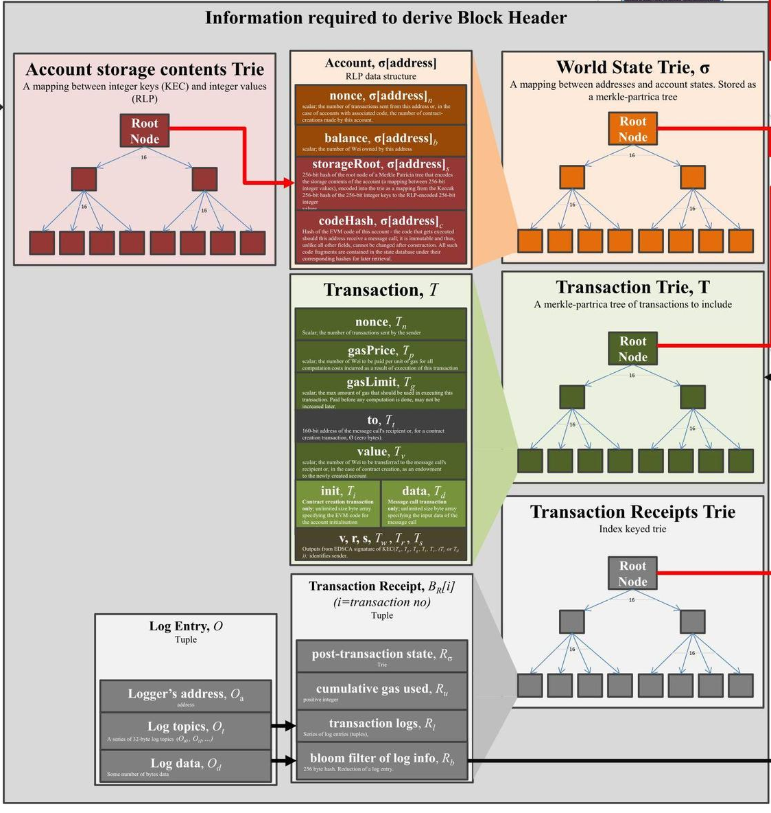
Block Format
Maintain state of all accounts
Aka world/global state
Include account balances, data stored, & smart contracts
List of TXs
List of TX receipts (i.e., effects of TXs)
Ethereum uses 3 Merkle trees (known as Trie), one each for integrity of:
World State
TXs
TX Receipts
Source: https://ethereum.stackexchange.com/
Questions/268/ethereum-block-architecture
Notes:
Let’s talk about block format in Ethereum.
A block keeps track of the entire state known as the world or global state. The world state consists of:
All account-balances
SC code
Data stored by SCs
As we can see from the diagram, an Ethereum block is more complicated than Bitcoin because it also keeps track of TXs and outputs/results of TXs.
The results of a TX is called the TXs receipt and they reflect changes in the ledger state due to the TX.
Each of these data is captured in a block as the root of the respective Merkel tree.
Merkel tree implementation in Ethereum is called Trie.

Slide 34
Ethereum Protocol
Ethereum’s inter-block time > block propagation time around the globe
Bitcoin inter-block time >> block propagation time around the globe
Small block size helps to propagate faster
Ethereum 1.0 with PoW
Multiple competing blocks were more likely
GHOST (Greedy Heaviest Observed Subtree) protocol linked orphaned blocks (called uncles) to increase the weight of chain
Uncle block miners received 87.5% of a standard block reward
Ethereum 2.0 with PoS
Only 1 validator is pseudo-randomly chosen to propose a block
Notes:
12-15 sec inter-block time is only marginally higher than the time to propagate the newly generated block to a large fraction of the network.
Small blocks help Ethereum to achieve short inter-block time, as they can be propagated to other BC nodes much faster.
Whereas Bitcoin has a 10 min inter-block time giving ample time for a block to propagate.
In Ethereum 1.0, due to the lower inter-block time, it was quite likely that multiple competing valid blocks were created simultaneously while another miner’s newly created block continues to propagate the network.
To overcome this problem Ethereum 1.0 used a protocol called GHOST (Greedy Heaviest Observed Subtree).
GHOST is a bit complicated. The main idea was to link up orphaned blocks (in Ethereum’s terminology they are called uncle blocks) with successor blocks to make a computationally heavier chain. Following Nakamoto consensus heaviest chain eventually wins (not the longest chain of blocks).
Uncle - a child of a parent of a parent of a block that is not the parent
The weight is determined based on the number of uncle blocks attached to a block.
Miners reference uncle blocks to add weight to their chain. This recognition is backed by a strong financial incentive mechanism, e.g., miners of uncle blocks receive 87.5% of a standard block reward. For every included uncle, the miner gains an additional 3.125%
As per the Ethereum 2.0 protocol, only 1 miner is randomly selected to propose a block in a given round. Therefore, it is not susceptible to simultaneous block generation.

Slide 35
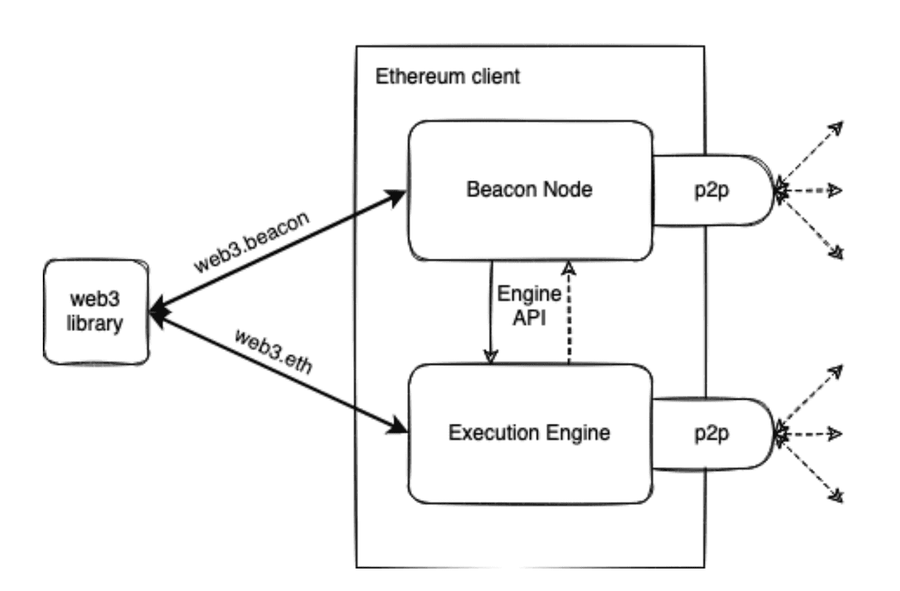
Ethereum Client & Nodes
Client – Implementation of Ethereum that verifies data against protocol rules
Node – Instance of Ethereum client software that is connected to others
Ethereum 1.0
Single client for TX execution & consensus
Ethereum 2.0
Execution client (aka Execution Engine, EL client, or Eth1 client) – Execute TXs & hold world state
Consensus client (aka Beacon Node, CL client, or Eth2 client) – Implements PoS consensus
Source: Nodes and clients | ethereum.org
Notes:
A “client” is an implementation of Ethereum that verifies data against the protocol rules and keeps the network secure.
A "node" is any instance of Ethereum client software that is connected to other computers
Ethereum 1.0 used a single client software to execute TXs, maintain the ledger state, and achieve consensus.
Whereas Ethereum 2.0 separates TX execution from consensus by having 2 clients that work together on the same node (see figure from Ethereum documentation, but note the abuse of terminology).
Execution client (aka Execution Engine, EL client, or formerly the Eth1 client) listens to new TXs broadcasted in the network, executes them, and holds the latest state, and world state.
The consensus client (aka Beacon Node, CL client or formerly the Eth2 client) implements the PoS consensus algorithm, which enables the network to achieve agreement based on validated data from the execution client.
This separation was to enhance modularity and let the existing execution clients run without breaking it or introducing new vulnerabilities.

Slide 36
Question
Mark True or False for each the following statements about a Bitcoin & Ethereum
 | True | False
Immutability in Bitcoin is probabilistic
Bitcoin uses account-balance model to keep track of assets while Ethereum uses UTXOs
Even through a TX got included in a block, it may eventually get dropped
Compared to Bitcoin, throughput of Ethereum is higher
✓
✓
✓
✓
Notes:
Due to the Nakamoto consensus, a block containing a TX may not be in the longest chain after a while. And there is a non-zero probability that this may happen even after multiple confirmation blocks. Therefore, 1st statement is True.
2nd question is wrong as how states are managed across the 2 BCs are reversed, i.e., Ethereum uses an account-balance model while Bitcoin uses UTXO.
3rd question arise from 1st question. Due to non-zero probability a TX that got included in a block may eventually belong to an orphan block. The TXs on that block then go to the TX pool. While waiting in the TX pool, some of those TXs can get dropped, particularly if they were waiting in the pool for a very long time. See Slide 24.
This is quite unlikely in Ethereum 2.0 due to its PoS design (as there will not be any uncle blocks). However, under major attack on the blockchain this may be possible, but quite unlikely.
The last question is tricky. To answer this question, we can do a rough calculation based on the numbers in Slide 32.
In the context of BCs, throughput is the no of TXs included in a block per second.
So, Ethereum can include a maximum of 475 TXs in a block. Assuming a block is built every 15 sec, throughput is 475/15 = 31.67
Bitcoin on average includes 1500 TXs in a block. Assuming a block is built every 10 min, throughput is 1500/10*60 = 2.5
In practice, the average throughput of Bitcoin is considered to be 3-7 TX/sec while it’s 15-25 per Ethereum.

Slide 37






Hyperledger
An umbrella project of a set of open-source blockchains & related tools
Global collaboration, hosted by Linux Foundation since Dec. 2015
Hyperledger Fabric is an enterprise blockchain framework
Private & permissioned blockchain
Modular architecture, e.g., can change consensus algorithm
Smart contracts are called “Chaincode” – Go, node.js, or Java
No concept of TX fee
Can achieve much higher TX throughput with low latency
1,000+ public TXs or 500+ private TXs per second
Notes:
Hyperledger is an umbrella project of a set of open-source blockchains and related tools.
The logs show some of the BCs frameworks under Hyperledger.
Hyperledger is hosted by the Linux Foundation with over 100 members.
Hyperledger Fabric (HLF) is a business blockchain framework intended as a foundation for developing blockchain-based applications. We’ll focus on HLF in this class. Besu is essentially Ethereum without gas fees.
It was initially developed by IBM.
It’s a private-permissioned blockchain.
All Hyperledger frameworks are modular, e.g., In Fabric and Sawtooth, you can change the consensus algorithm.
SCs in Hyperledger are called Chaincode and can be developed in multiple languages
No concept of the TX fee.
These BC platforms can achieve much higher TX throughput (i.e., no of TXs processed per unit time) with low latency compared to public-permissionless BC.
Under a well-optimised design, it’s possible to achieve about 1,000 TXs/sec.

Slide 38
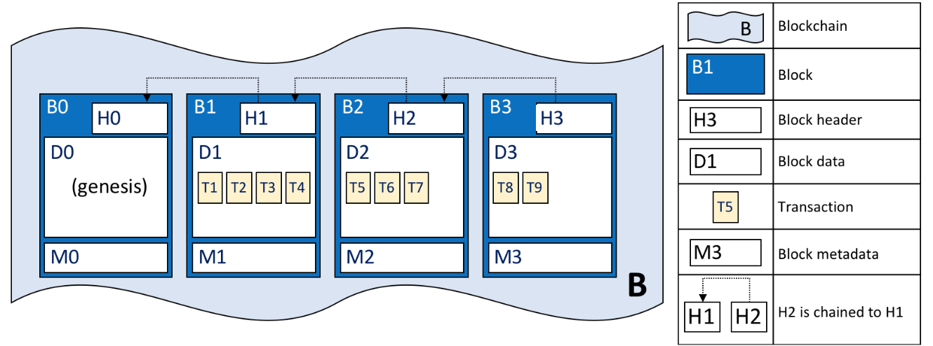
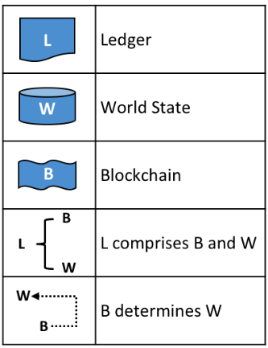
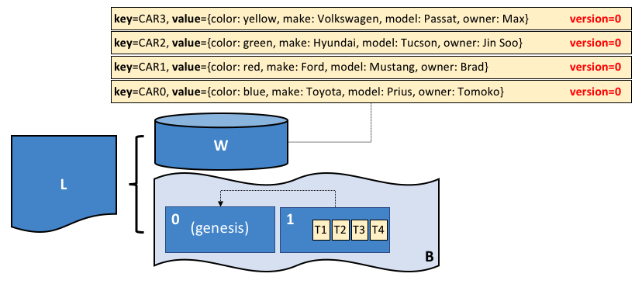
Hyperledger Fabric – Transactions & Blocks
Source: https://hyperledger-fabric.readthedocs.io/en/release-2.0/ledger/ledger.html
Notes:
The block format in HLF is similar to other BCs.
The only difference is there’s no nonce as a special node called the orderer decides what TXs go into a block and their order.
Block metadata is not very different from other attributes included in block headers in Bitcoin and Ethereum.
As the 2nd figure shows, the ledger includes both the world state and blocks including their TXs.
Similar to Ethereum, the HLF world state is also maintained as account balances.
Here keys are like account numbers and values are the state/balance. Being a 2nd generation BC, HLF can store any form of data are value.
If you are familiar with key-value stored in NoSQL databases HLF is not very different. HLF uses LevelDB or CouchDB as the underlying data store for the ledger. The key-value store in HLF is more visible compared to that in Ethereum which uses the same ideas though it’s not directly visible to developers.

Slide 39
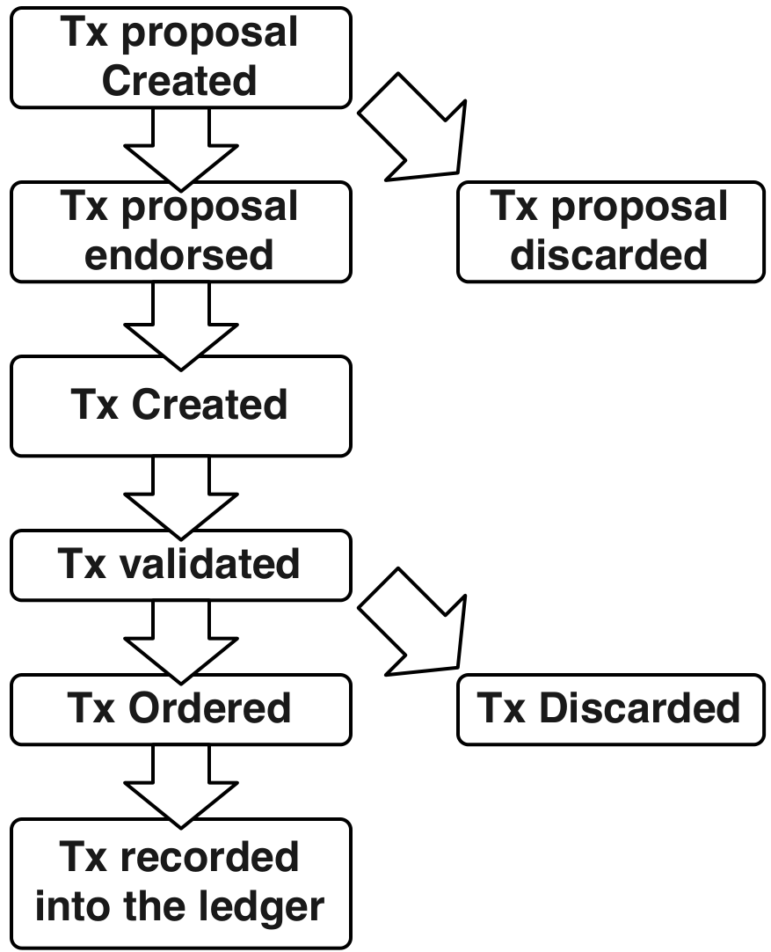
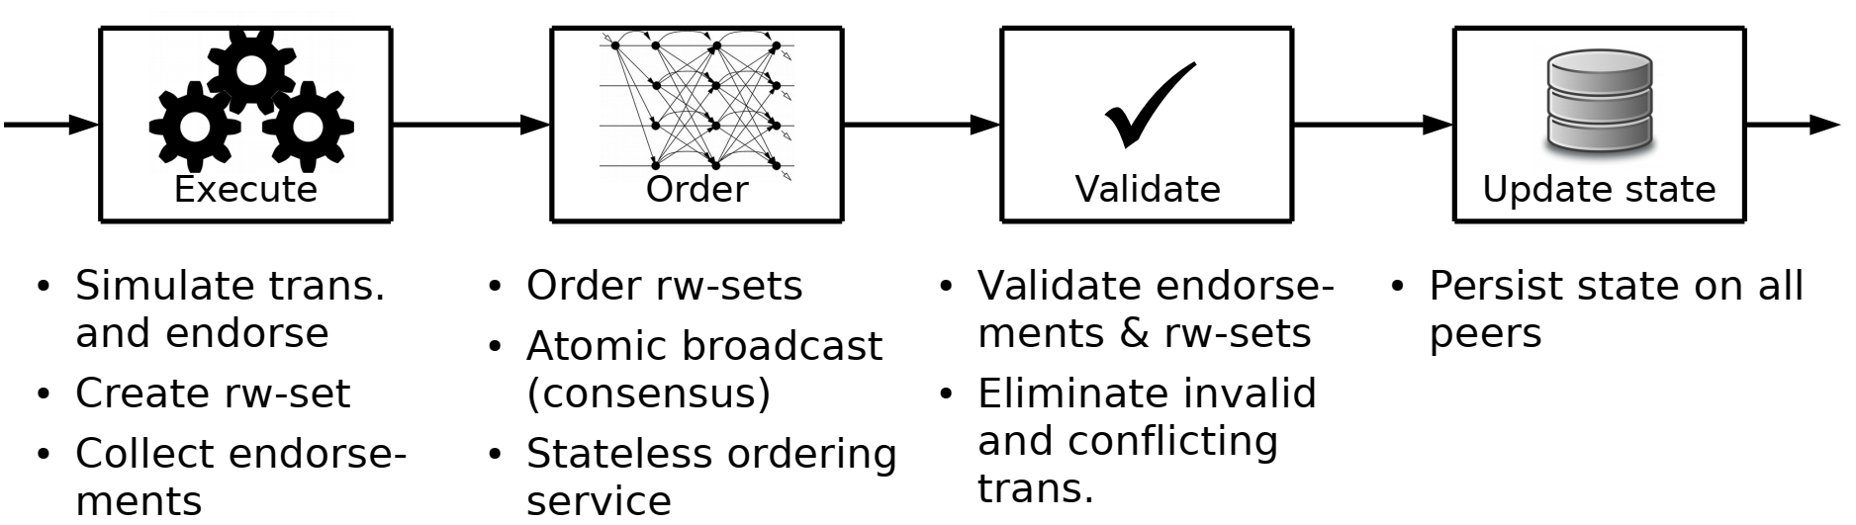
Hyperledger Fabric Transaction Lifecycle
rw-set – Read-Write set
Source: Androulaki et al., “Hyperledger Fabric: A Distributed Operating System for Permissioned Blockchains”, EuroSys ’18, April 23–26, 2018.
TX is finalized at this point
Notes:
These figures illustrate the lifecycle of a TX in Hyperledger.
Once a TX is proposed to be included in the ledger, it needs to be first endorsed by a set of nodes.
The nodes responsible for endorsement will check the authenticity of the TX, whether it is valid given the ledger state, and then put its digital signature as an endorsement of the TX.
This is like getting your TX notarised.
If the TX is invalid (e.g., Alice doesn’t have enough money), it is discarded.
An endorsed TX is sent back to the TX sender that proposed the TX.
Once the TX sender collects enough endorsement as per the set endorsement policy, TX is assumed to be in the “created” state.
A simple endorsement policy could be “Organisation A’s TXs must be endorsed by any 2 of Organisation B, C, and D”
The TX sender combines multiple endorsements as per the endorsement policy and then sends all of them to a special node called the orderer.
Once a TX reaches the orderer, it validates the endorsement based on the pre-defined policy.
If valid TX is ordered by putting it into a block. Else, it’s dropped
Then the block is broadcasted to all the nodes in the network to update their ledger.
Finally, the TX is recorded on the ledger.
TX is finalized at this point. We don’t need to wait for multiple confirmation blocks like in Bitcoin.
Here’s another way of looking into this process.
The TX is executed and if valid it is endorsed.
However, instead of updating the ledger, the state of the ledger before and after executing the TX is recorded as a read-write set (rw-set). The read set includes the ledger state before executing the TX and the write set includes the state after executing the TX.
If the endorsement policy requires more than one endorsement, all endorsements need to be collected too.
The endorsed TX is sent to a special node called the orderer that orders TXs into a block.
Order first validates the endorsements attached to the TX. Orderer doesn’t execute the TX.
It then builds a block by packing multiple valid TXs into it. This essentially forms a global order among concurrent TXs.
E.g., if Alice, Bob, and Chaile’s TXs were waiting to be included in a block, the order may order them as Bob, Charlie, and Alice.
The orderer then broadcasts the block to all nodes in the network.
Orderer is stateless and just orders TXs as it wishes.
Once a TX is received, nodes validate the endorsement and read-write set of a TX.
If it’s invalid or the ledger state is changed between the collection of the read-write set and validation, it’s dropped.
This could happen due to concurrent TXs, where the state read by one TX may have been updated by another TX that got finalised. If so, the client needs to resubmit the TX.
In practice, rw-set conflicts are possible but rare, and you can design your application to minimise such scenarios.
Finally, the ledger is updated based on the information in the rw-set.
TX doesn’t get executed again, instead, the current ledger state is replaced with the write set.
This executes → order → Validate model is different from the approach taken by BCs like Bitcoin and Ethereum where they follow Execute → Validate → Order TXs model. All these steps happen as part of the block-building process.

Slide 40
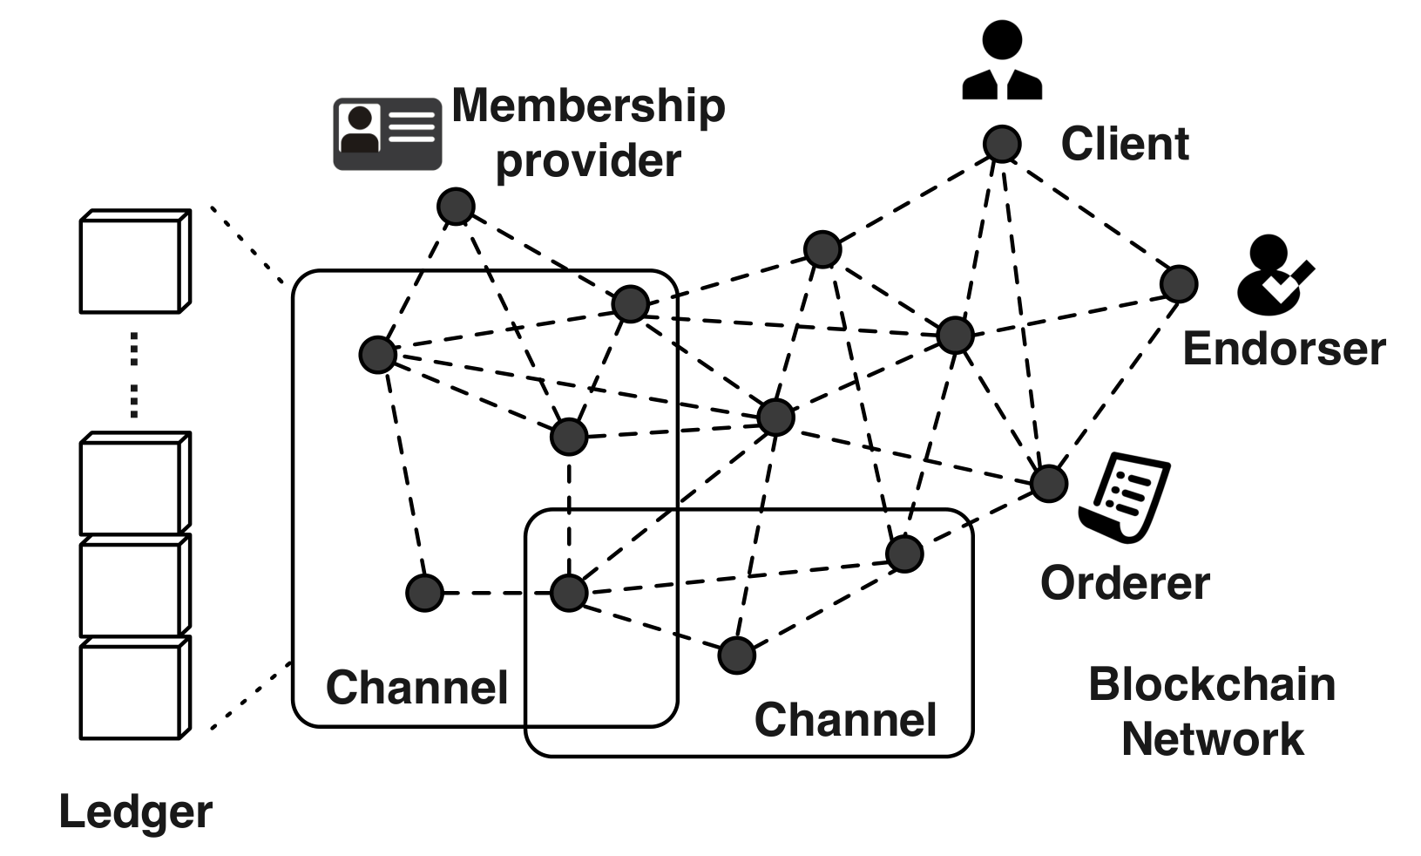
Hyperledger Fabric Network
Membership Service Provider (MSP)
Users & nodes must enrol with MSP & have known identities
MSP is trusted
Public keys as cryptographic certificates tied to organisations, network components, & users
Channels
Subnetworks – Allow a group of members to create a private ledger
Built for scenarios where business confidentiality is important → Reduced transparency is acceptable
Private Data Collections (PDC)
Hide data in a TX from other channel members
Notes:
As seen from the figure, Hyperledger Fabric (HLF) network has a set of components and nodes. The figure is taken from the textbook.
A membership Service Provider (MSP) is an identity provider service that links parties to their organisation.
E.g., alice.company.com indicates that Alice is from company.com
All participants have known identities, and they need to enrol with the MSP.
Public keys are used as cryptographic certificates (aka public key certificates) that are tied to organisations, network components, and end-users.
MSPs link identifiers to respective organisations.
MSP is trusted by all the participants – Here we see that the trust assumption is relaxed compared to public BCs.
MSP is just a service, not a physical node.
Channels
In addition to enforcing participation at the network level, HLF can further group nodes into a set of channels.
Channels are like subnetworks within the main network, that allow a group of members to create a private ledger.
Data access control is applied on network and channel levels, so only members of a channel can access data in the respective ledger enhancing privacy.
Therefore, channels are useful in scenarios where business confidentiality is important.
This means only a subset of BC members will be in a channel. Hence, transparency is reduced, but acceptable in an enterprise setting.
Private Data Collections (PDCs) provide a mechanism to hide data within a TX for other channel members. E.g., the regulator may see the amount/volume of something sold but not its price.
Note that PDCs are not depicted in the figure.
Let’s talk about clients, orderer, and endorsers in the next slide

Slide 41
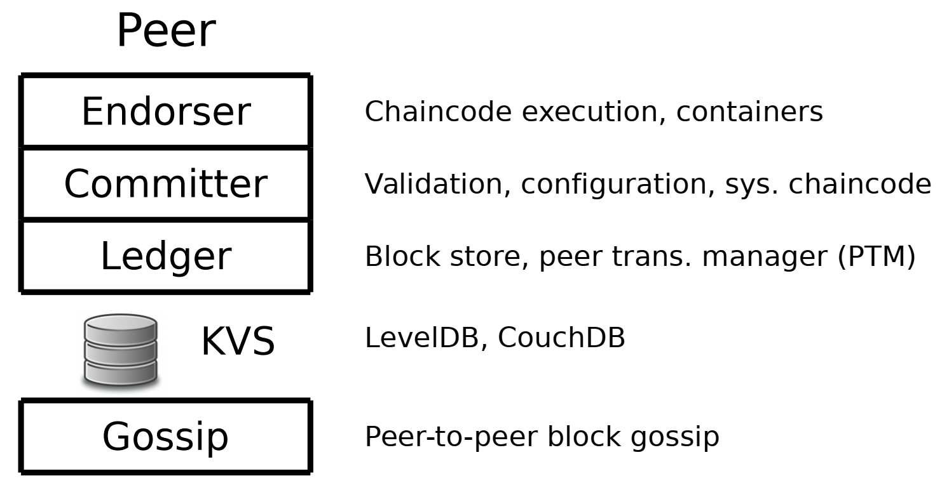
Hyperledger Fabric Node Types
Client
Connects to peers to communicate with blockchain on behalf of users
Send TXs & observe updates
Can connect to (multiple) channels, but is unaware of other existing channels
Peer
Receives ordered TXs from orderer, commits TXs, & maintains ledger state
Can play a special role like endorser
TXs invoking chaincode needs to be endorsed before being committed
TXs must satisfy channel & chaincode-specify endorsement policies
Orderer
Validates & orders TXs into a block, then broadcasts it to the network
Provides a communication channel between clients & peers
Single orderer service prevents multiple competing blocks
Notes:
The main node types are:
Clients – Issue TXs. They need pre-authorisation from MSP
Peers – Maintain ledger state
Endorsers – Confirm TXs
Orderers – Order TXs
There is no good way to introduce these nodes types in a particular order as they are interconnected.
A client connects to peers in the HLF network to communicate on behalf of an end user.
It can be used to create & send TXs, as well as observe updates.
A client may connect to multiple channels but is unaware of other existing channels that it’s not part of.
Peers are the nodes of the BC network.
What we see in this figure is the different layers of a peer.
A peer maintains the ledger state and commits TXs ordered by the orderer.
It can also play a special role like an endorser.
In Hyperledger every TX invoking chaincode needs to be endorsed/confirmed/notarized before being committed.
Therefore, before submitting a TX, it needs to be endorsed by one or more endorsers, who will run the chaincode and verify that the TX is valid.
Chaincode can specify an endorsement policy that defines the conditions for valid TX endorsement.
You can also define an endorsement policy for a channel. If both are defined, a TX must satisfy both of those policies before being included in the ledger.
E.g., a policy like org1.peer AND org2.peer means a peer role from both org1 and Org2 needs to endorse a TX for it to be valid.
Before endorsing a TX, the endorser will first validate the TX, execute it, and create a read-write set.
As the name implies, the Orderer orders TXs within the Hyperledger network creating a global order of TXs
It validates (i.e., checks whether TX satisfies the endorsement policy, but doesn’t execute it) and orders TXs into a sequence/block, then broadcasts them to the network.
Provides a communication channel between clients and peers.
As the orderer is the only one that builds a block, it’s not possible to have multiple competing blocks like Bitcoin and Ethereum.
A set of orderers could be used to support multiple channels and achieve high availability. Even in that case, only 1 of them will be the primary orderer to build blocks. If that fails, another orderer will take over.

Slide 42
Question
Which of the following statement(s) is True?
As Hyperledger uses a Membership Service Provider (MSP), it’s not required to sign TXs
Consensus algorithm in Hyperledger Fabric is based on PoW
Both Ethereum & Hyperledger Fabric maintain World State as a set of accounts & balances
Finality (i.e., time to confirm a TX) in Hyperledger Fabric is immediate
X
X
✓
✓

